Slide 1
ACCURATE AND ROBUST SALIENCY DETECTION
By
P.SATVIKA(197R1A05N7)
PARANKUSHAM VAISHNAVI(197R1A05N8)
MAMINDLA MOUNIKA(197R1A05M7)
Under the Guidance of
DR. K. SRUJAN RAJU

Slide 2
Abstract
In this project, we design a simple yet powerful deep network architecture U2 -Net, for saliency detection.
U2-Net architecture allows the network to go deeper, attain high resolution, without significantly increasing the memory and computation cost.
This is achieved by a nested U-structure. On the bottom level, with a Residual U-block module and on the top level, there is a U-Net like structure, in which each stage is filled by a RSU block.

Slide 3
Existing System
Deep convolutional neural networks (CNNs), especially the Fully Convolutional Networks (FCN) in image segmentation are used for saliency detection.
There is a common pattern in the design of most saliency detection networks , that is, they focus on making good use of deep features extracted by existing backbones such as Alexnet, VGG, ResNet, ResNeXt, DenseNet, etc..
Deeplab is an architecture which was widely used for semantic segmentation before U2-Net . Its major contribution is the use of Atrous Spatial Pyramid Pooling (ASPP) operation at the end of the encoder. While the model works extremely well, its open source code is hard to read.

Slide 4
Disadvantages
As the features are extracted on regular spatial regions (pixels or patches), they cannot preserve the object shapes adaptively.
Moreover, the obtained saliency maps are heavily blurry because of down sampling the image to keep computationally efficient.
Object borders or textured regions are overemphasized.
The model fails when frames are in motion.

Slide 5
Proposed System
Our main contribution is to propose a simple network architecture, called U 2 –Net.
U2 -Net is a two-level nested U-structure that is designed for saliency detection without using any pre-trained backbones from image classification.
This architecture allows the network to go deeper, attain high resolution, without significantly increasing the memory and computation cost.
Residual connections within each U-Net block enables focus on local details while the overall residual U-Net architecture enables fusing these local details with global (multi scale) contextual information.

Slide 6
Advantages
It is able to capture more contextual information from different scales. Thanks to the mixture of receptive fields of different sizes in our proposed Residual U-blocks (RSU).
It increases the depth of the whole architecture without significantly increasing the computational cost because of the pooling operations used in these RSU blocks

Slide 7
Hardware Requirements
For developing the application , the following are the hardware requirements:
System : Minimum of Intel core i3 processor.
Hard Disk : 4 GB (minimum).
Monitor : 14’ Color Monitor.
Mouse : Optical Mouse.
RAM : 8GB and higher.

Slide 8
Software Requirements
Operating system : Windows 7 and above.
Coding Language : Python.
Design : HTML.
Tools : Pycharm

Slide 9
Applications
The applications are grouped into three categories.
The first one uses the detection of the most important regions in an image and contains applications such as audio surveillance, defect detection, pathology detection, expressive and social gestures, computer graphics.
The second category uses saliency maps to detect the regions which are the less interesting in an image. Here one can found applications like texture metrics, compression, summarization, watermarking and attention-based ad insertion.
Finally, a third category uses the most interesting areas in an image with further processing like comparisons between those areas. In this category one can find image registration and landmarks, object recognition, action guidance in robotics or avatars, web sites optimization, symmetries and automatic focus on images.

Slide 10
Methodology
The constituent unit of the U²-Net is the Residual U-block (RSU), a U-shaped Encoder-Decoder structure consisting of symmetric convolutional layers.
Inspired by U-Net, RSU allows image features of various scales to be extracted through sequential downsampling on the encoder side. Features extracted at each level are preserved and directly added to the corresponding layers on the decoder side during the upsampling process.
In the U²-Net, RSUs are stacked in a manner similar to how each of them is constructed - a U-shape Encoder-Decoder. There are 6 units in the encoder and 5 in the decoder. Each level produces a saliency map, which is combined together with the other maps to form the final output.

Slide 11
Novelty
Our project about predicting where people look in a scenario, which is relevant in many applications. For example, in advertising, it may be important for the producer to know if the key concept catches the viewer’s eye. Furthermore, if one knows where people are likely to look in an advertisement, relevant content can be placed there.
Another application that might take advantage of human gaze prediction is image editing. Knowing where the viewer looks could help to create smoother shot transitions.

Slide 12
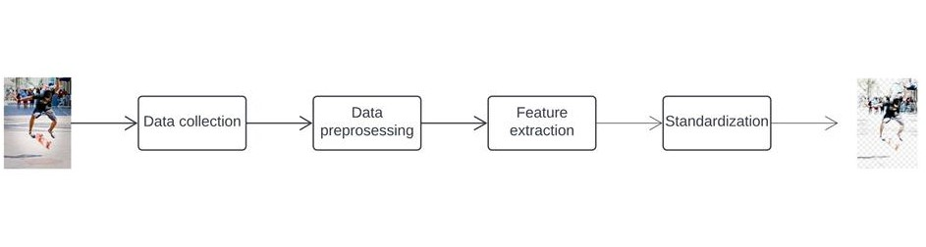
Architecture

Slide 13
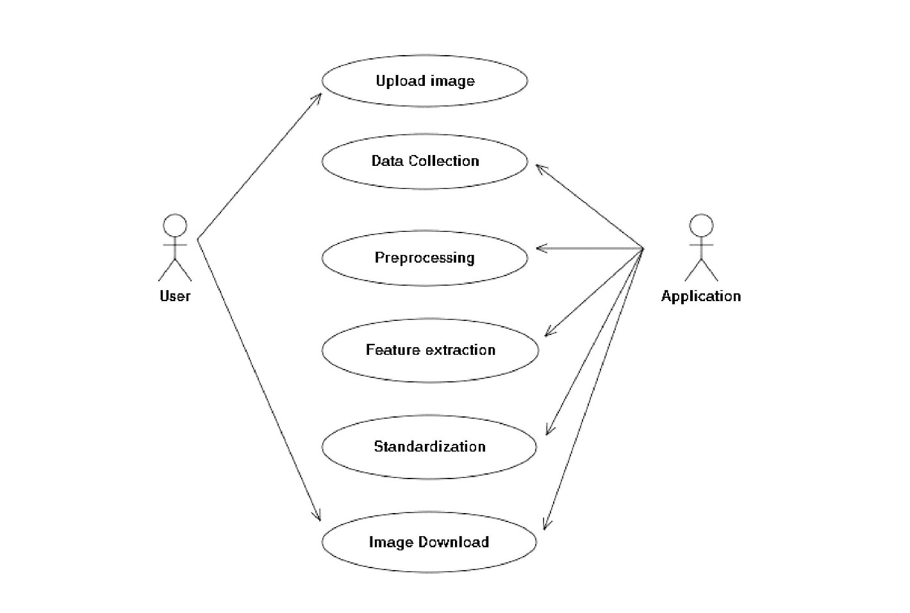
UML Diagrams
Use Case Diagram:

Slide 14
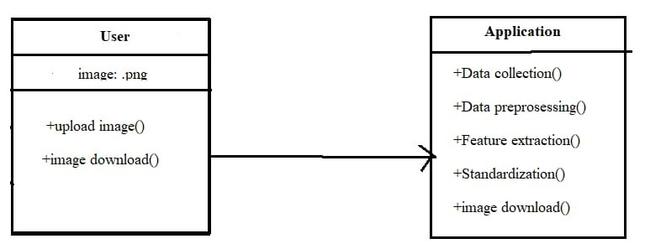
.
Class Diagram

Slide 15
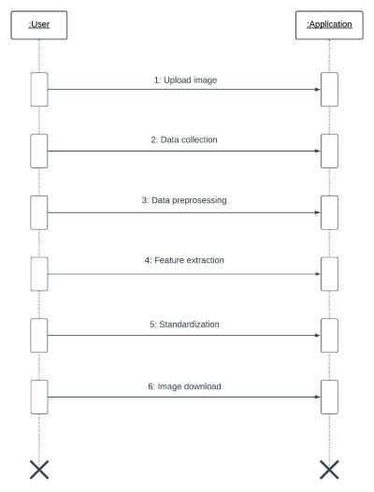
.
Sequence Diagram

Slide 16
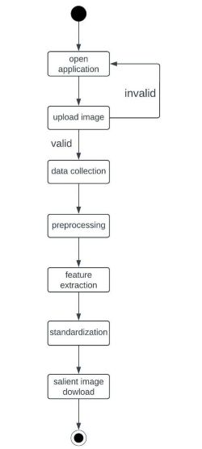
.
Activity Diagram

Slide 17
Sample Code
import os
import base64
import math
#from app import app
from flask import flash, request, redirect, url_for, render_template,Flask
from werkzeug.utils import secure_filename
import io as io_norm
from skimage import io
import torch
from torch.autograd import Variable
from torch.utils.data import Dataset, DataLoader
from torchvision import transforms
from PIL import Image
import glob

Slide 18
.
import numpy as np
from PIL import Image
import glob
from data_loader import RescaleT
from data_loader import ToTensor
from data_loader import ToTensorLab
from data_loader import SalObjDataset
from model import U2NET # full size version 173.6 MB
from model import U2NETP # small version u2net 4.7 MB
UPLOAD_FOLDER = "static/uploads"
FINAL_FOLDER = "static/final"
app = Flask(__name__)
app.secret_key = "secret key"

Slide 19
app.config["UPLOAD_FOLDER"] = UPLOAD_FOLDER
app.config["FINAL_FOLDER"] = FINAL_FOLDER
app.config["MAX_CONTENT_LENGTH"] = 16*1024*1024
def normPRED(d):
ma = torch.max(d)
mi = torch.min(d)
dn = (d-mi)/(ma-mi)
return dn
def convert_img(image_name,pred,d_dir, org_img_path):
predict = pred
predict = predict.squeeze()
predict_np = predict.cpu().data.numpy()
org_img = Image.open(org_img_path)

Slide 20
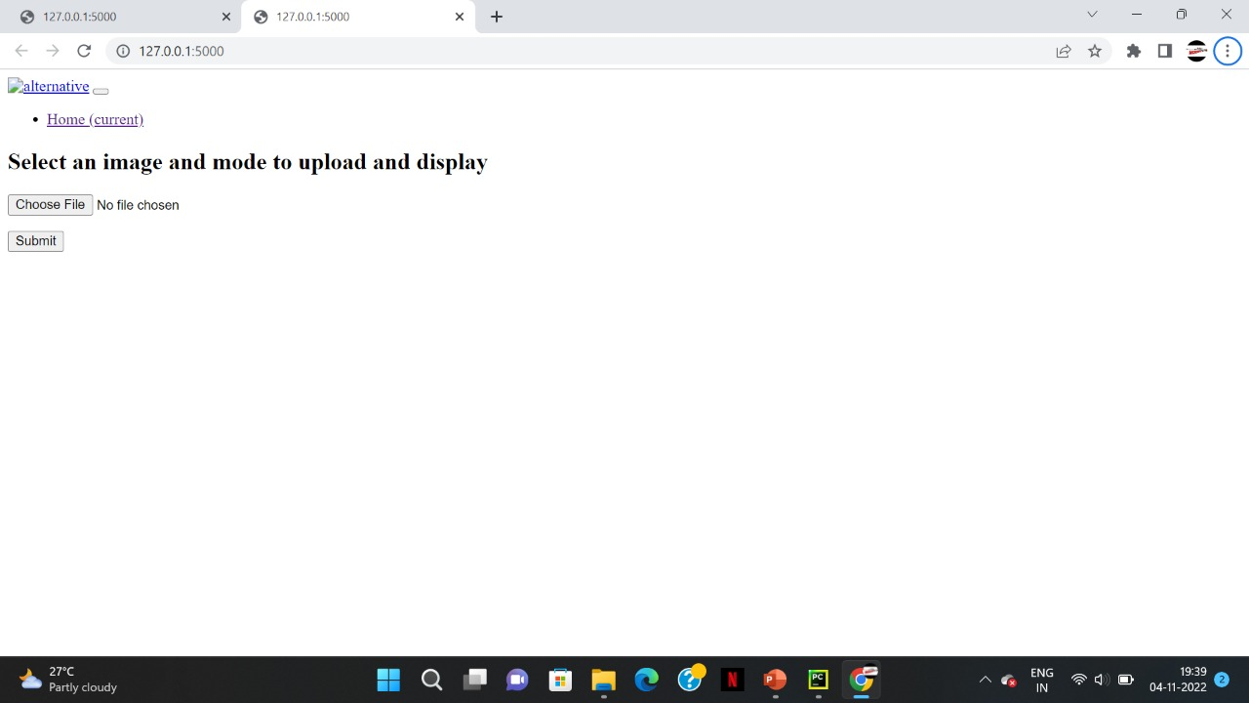
Screenshots

Slide 21
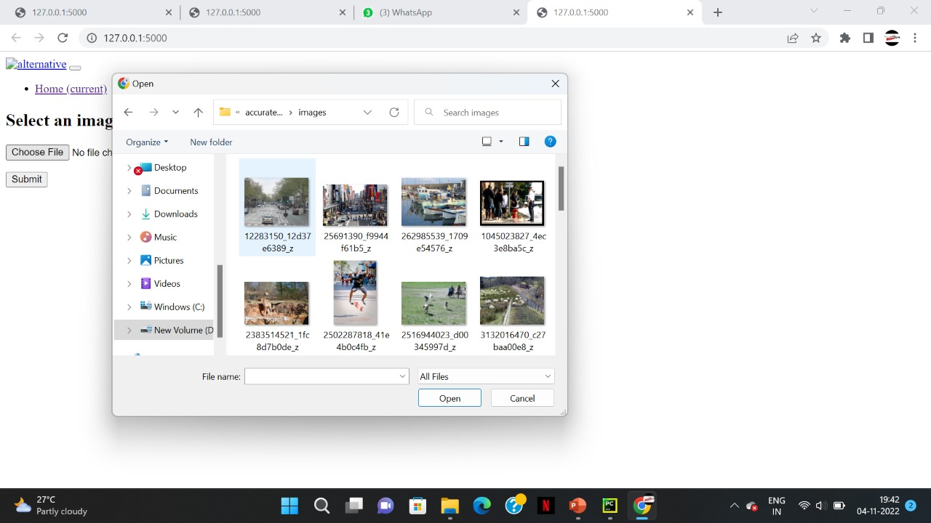
.

Slide 22
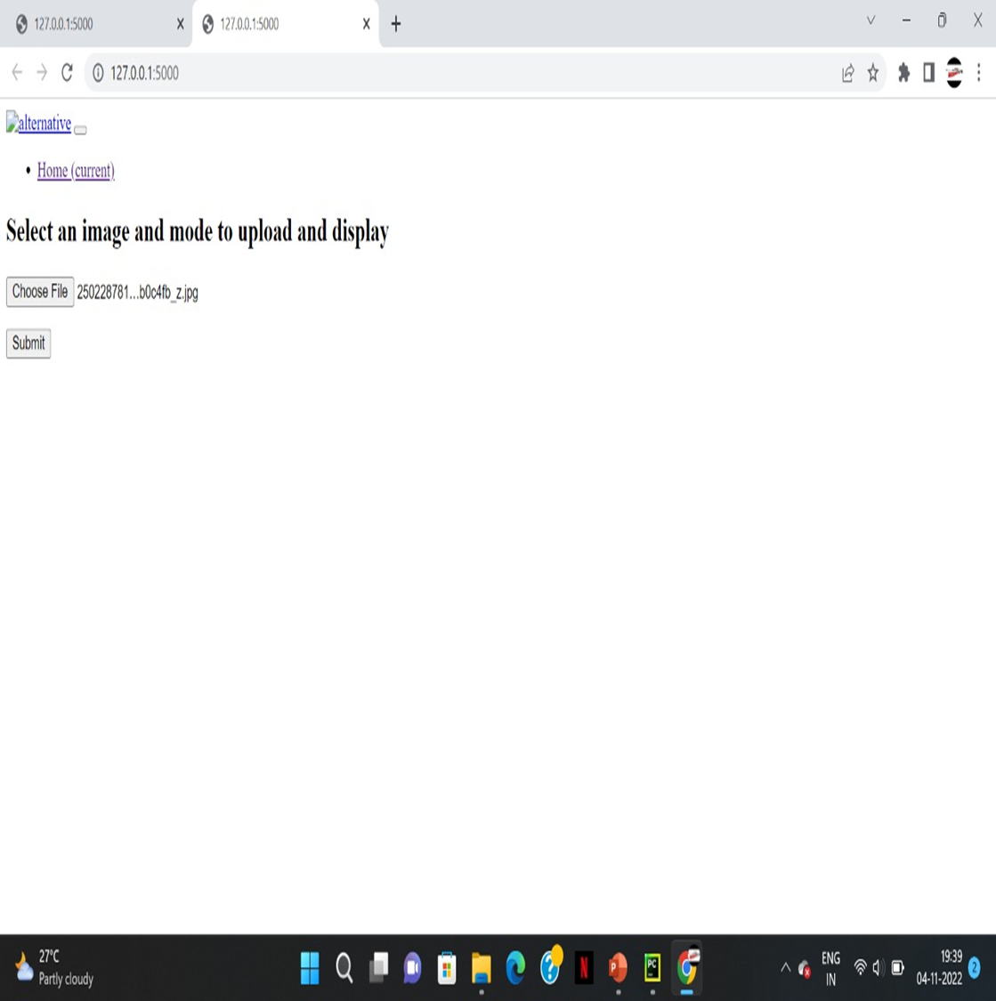
.

Slide 23
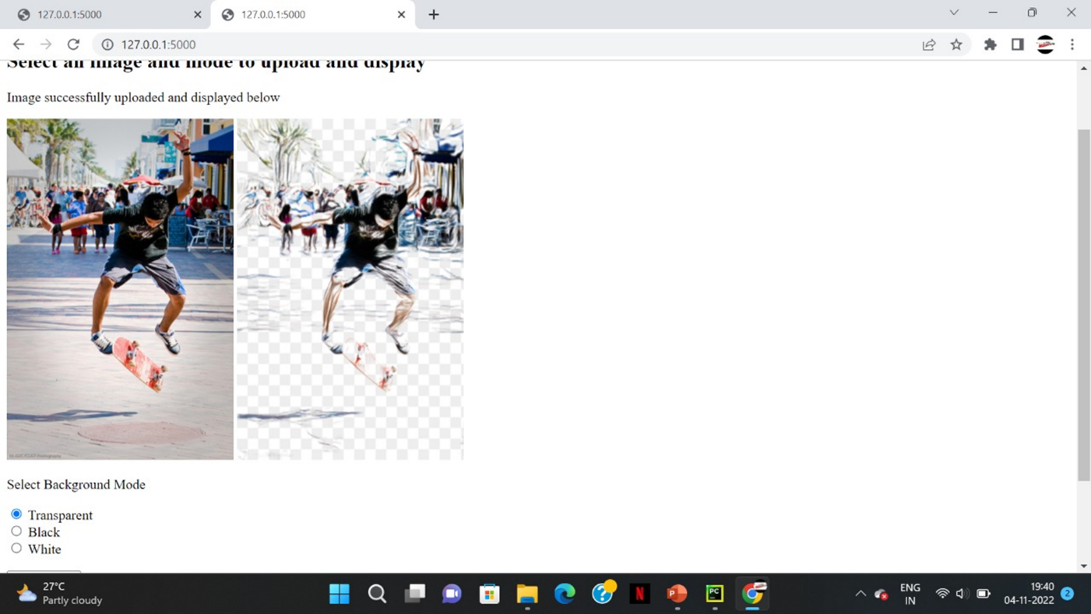
.

Slide 24
Conclusion
The main idea is to propose a novel deep network: U2 - Net, for saliency detection.
Compared with those saliency detection models built upon the existing backbones, our U2 -Net is purely built on the proposed RSU blocks which makes it possible to be trained from scratch and configured to have different model size according to the target environment constraints.
Experimental results on six public salient object detection datasets demonstrate that both models U2 - Net (176.3 MB)and U2 –Net (4.7 MB),achieve very competitive performance against other 20 state-of-the-art methods in terms of both qualitative and quantitative measures.

Slide 25
Future Enhancement
Although our models achieve competitive results against other state-of-the-art methods, faster and smaller models are needed for computation and memory limited devices, such as mobile phones, robots, etc.
In the near future, we will explore different techniques and architectures to further improve the speed and decrease the model size. In addition, larger diversified salient object datasets are needed to train more accurate and robust models.

Slide 26
References
S. Li, M. Xu, Y. Ren, and Z. Wang, “Closed-form optimization on saliency-guided image compression for hevc-msp,” IEEE Transactions on Multimedia, 2017.
M. Ding and R.-F. Tong, “Content-aware copying and pasting in images,” The Visual Computer, vol. 26, no. 6-8, pp. 721–729, 2010.
Y. Fang, Z. Chen, W. Lin, and C. Lin, “Saliency detection in the compressed domain for adaptive image retargeting,” IEEE transactions on image processing, vol. 21, no. 9, pp. 3888–3901, 2012.
H. Wu, G. Li, and X. Luo, “Weighted attentional blocks for probabilistic object tracking,” The Visual Computer, vol. 30, no. 2, pp. 229–243, 2014.

Slide 27
Thankyou

